Slide 1
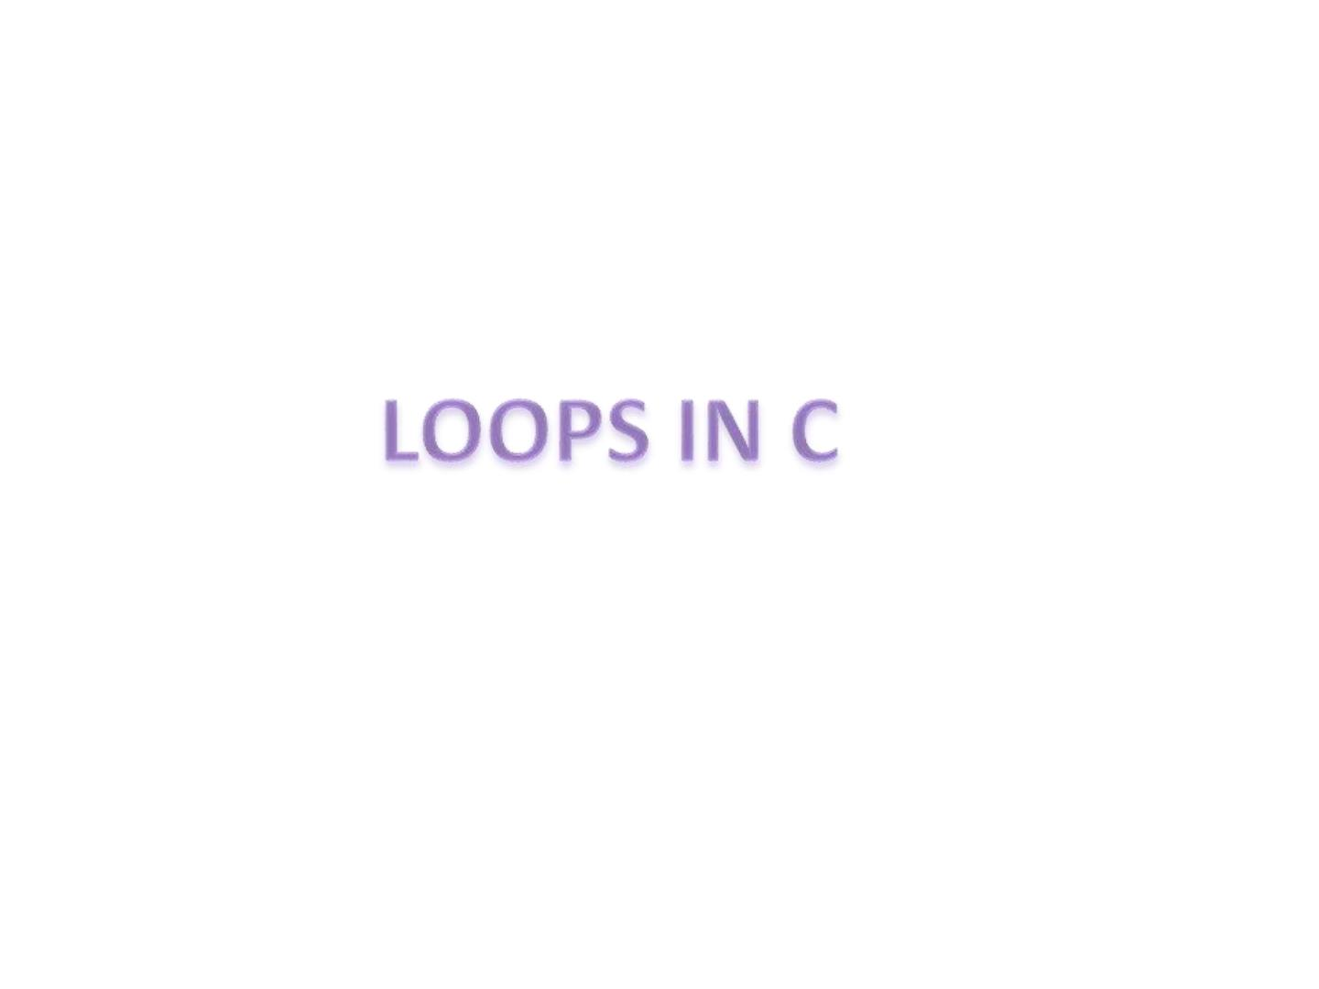
Md. Khaliluzzaman
Dept. of CSE
IIUC

Slide 2
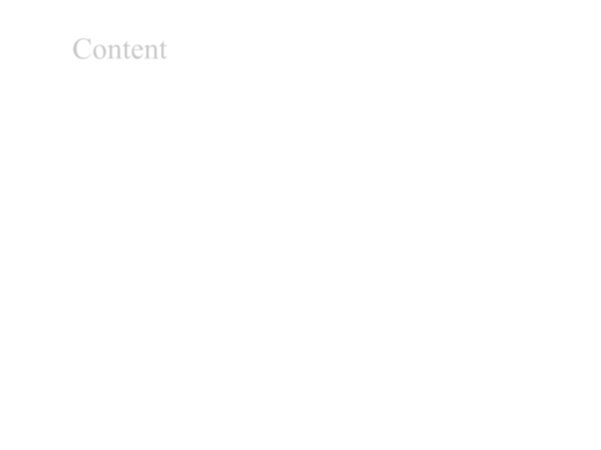
Content
➢ Objective
➢ Introduction
➢Types of looping
.for
.while
.do-while
➢ Assessment metric
➢Conclusion

Slide 3

OBJECTIVES
Course Objective
❖ Understand the basic terminology used in computer
programming
❖ It stresses the strengths of C, which provide students with
the means of writing efficient, maintainable, and portable
code.
❖ write, compile and debug programs in C language.
❖ Increase the ability to learn new programming languages

Slide 4
Topic Objective
❖ Understand the basics of looping.
❖ To use the for, while, and do-while repetition statement to
execute statements in a program repeatedly.

Slide 5
INTRODUCTION
❖ Loop statements are used to repeat the execution of
statement or blocks.
Iteration of a loop: the number of times the body of loop is
executed.
❖ Two types of loop structure are:
Pretest : Entry - controlled loop
Ex: for and while loop
Posttest : Exit – controlled loop
Ex: do …while loop

Slide 6
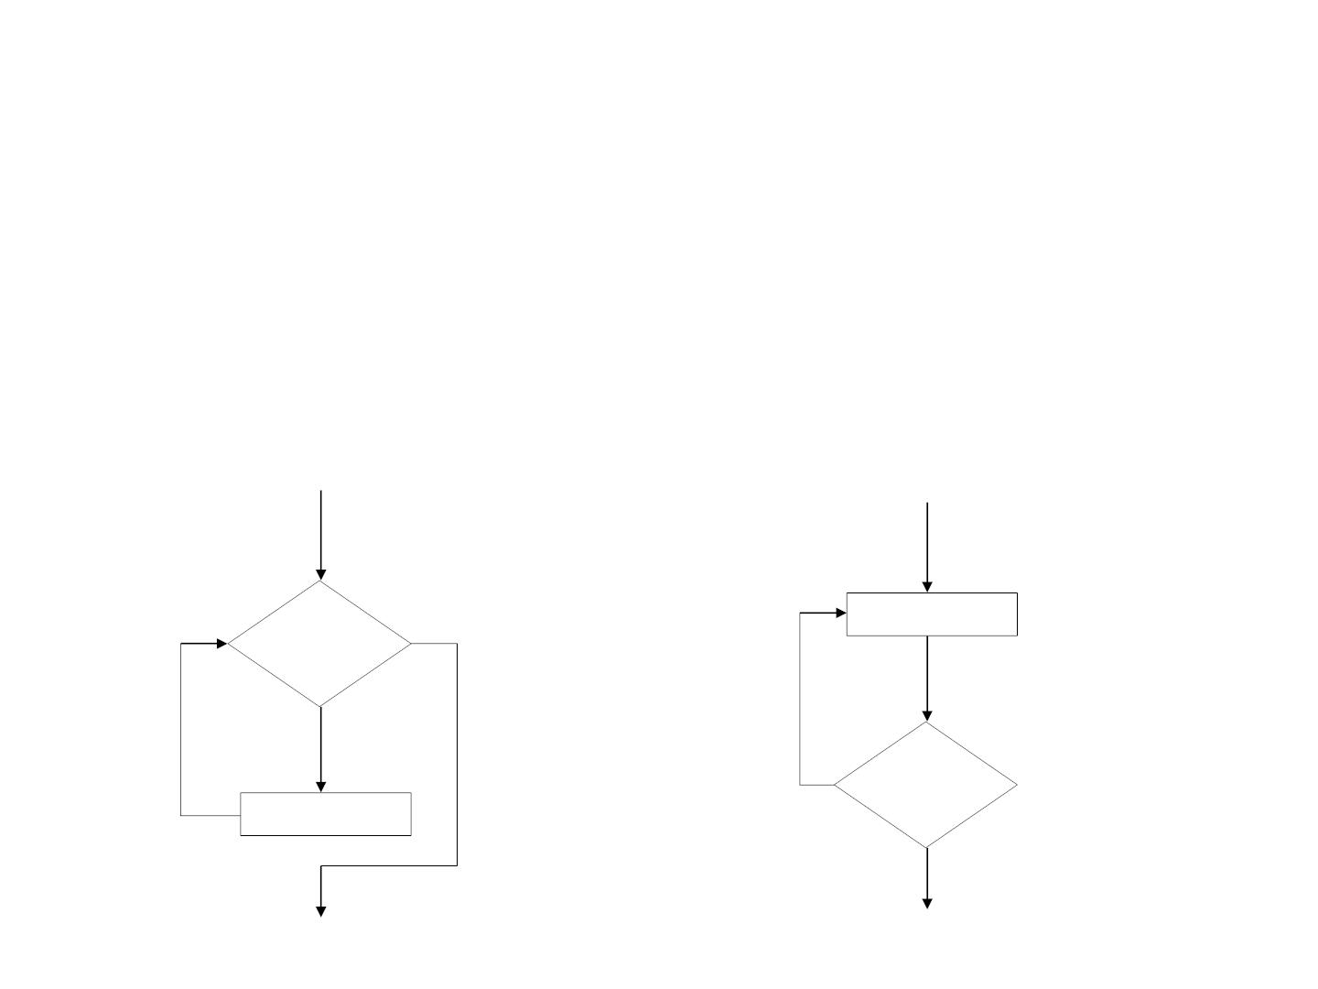
Pretest Vs. Posttest
Pretest : Condition is tested before each iteration to check
if loops should occur.
Posttest : Condition is tested after each iteration to check
if loop should continue (at least a single iteration occurs).
Statements
Conditio
n
Evaluate
d
true
false
true
Conditio
Statements
n
Evaluate
d
false

Slide 7
TYPES OF LOOP
for loop
❖ while loop
❖ do-while loop

Slide 8
for Loop
for loop has three parts:
❖ Initializer is executed at start of loop.
❖ Loop condition is tested before iteration to decide
whether to continue or terminate the loop.
❖ Increment/decrement is executed at the end of each loop iteration.

Slide 9
Syntax:
for ([initializer] ; [condition] ; [increment/decrement] )
{
[Statement block];
}
true
false
initilizer
Test condition
false
initialize the control variable
❖ Condition with control variable
❖ Increment/decrement control variable
true
Statements
Increment/decrement

Slide 10
Here,
i is the control variable, where, the condition is depend on the variable i.
Example:
for(i=0; i<3; i++)
{
printf(“Hello\n”);
}
Output:
Hello
Hello
Hello

Slide 11
while Loop
❖ It has a loop condition only that is tested before each
iteration to decide whether to continue or terminate the
loop.
❖ The body of a while loop will execute zero or more
times
Syntax:
while (<condition>){
<statement/block>;
}

Slide 12
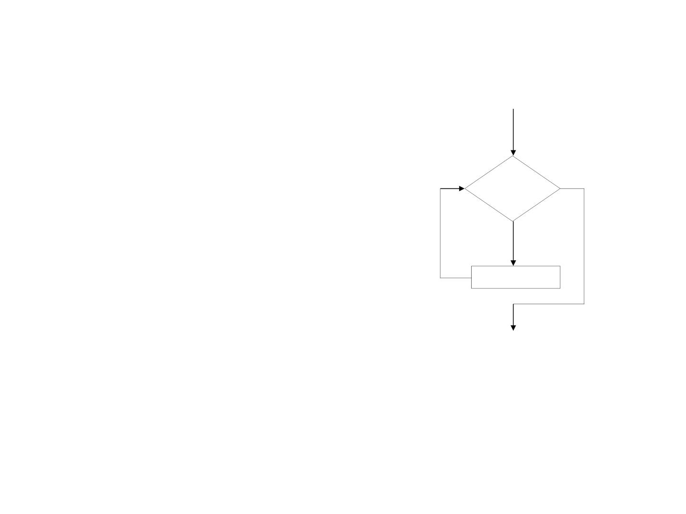
Example :
int i=0;
Flow diagram
while (i<3)
{
Condition
printf(“Hello\n”);
true
false
i++;
Statements
}
Output:
Hello
Hello
Hello

Slide 13
do…while Loop
❖ Do while has a loop condition only that is tested after
each iteration to decide whether to continue with next
iteration or terminate the loop.
Syntax:
do{
<statement/block>;
}while(condition);

Slide 14
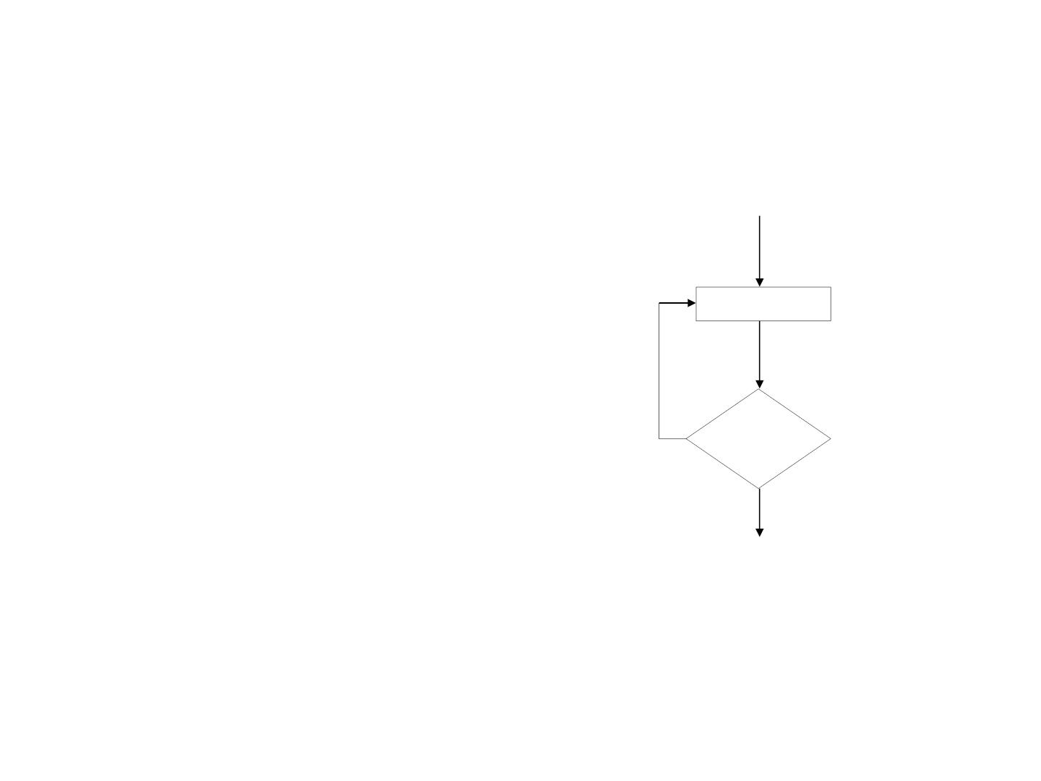
Example:
int i=0;
do{
Flow diagram
printf (“Hello\n”);
i++;
} while (i<3);
Statements
true
Output:
Condition
Hello
Hello
Hello
false

Slide 15
ASSESSMENT METRIC
❖ What is looping? List the types of looping.
❖ Explain the while loop with an example.
❖ Give the difference between while and do-while loops
❖ Explain the syntax of for loop with an example
❖ List out the difference between while and for loop. And also
explain the do-while loop.

Slide 16
CONCLUSION
❖ Importance of loops in any programming language is
immense, they allow us to reduce the number of lines in a
code, making our code more readable and efficient.

Slide 17


